Slide 1
بسمه تعالی
انواع الگوریتم‌های تکاملی
Evolutionary Algorithms
Presenter: Manouchehr Abdi

Slide 2
Evolutionary Algorithms
Genetic Algorithm (GA) — الگوریتم ژنتیک
Grey Wolf Optimization(GWO) – الگوریتم گرگ خاکستری
Bat algorithm الگوریتم خفاش-
Gorilla Troops Optimizer(GTO) الگوریتم گوریل-
Firefly Algorithm(FA) الگوریتم کرم شب تاب-
Honey Bee Algorithm (HBA)- الگوریتم زنبور عسل
Lion Optimization Algorithm (LOA) الگوریتم بهینه سازی شیر-
Ant Colony Optimization (ACO) الگوریتم بهینه سازی کلونی مورچه-
Whale Optimization Algorithm (WOA)- الگوریتم بهینه سازی وال یا نهنگ
Presenter: Manouchehr Abdi

Slide 3
Evolutionary Algorithms
الگوریتم های تکاملی
Evolutionary Algorithms (EAs) are a family of stochastic, population-based optimization and search algorithms inspired by biological evolution. They are used when the objective function is nonlinear, non-differentiable, noisy, discontinuous, or defined over complex discrete/continuous spaces.
Evolutionary algorithms are a class of algorithms that mimic the genetic improvements of human beings or the natural behavior of animals.
Presenter: Manouchehr Abdi

Slide 4
Core Idea?
Given an optimization problem:
an EA maintains a population of candidate solutions
and repeatedly applies
f(x) Evaluation — compute fitness
Selection — choose better individuals
Variation — crossover and/or mutation
Replacement — form the next generation
Termination — stop when a criterion is met
Presenter: Manouchehr Abdi

Slide 5
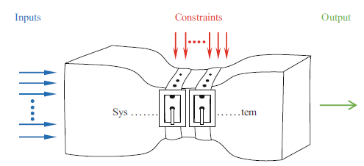
Single-Objective Optimisation
Single-objective optimisation refers to the process of finding the best possible solution for a problem that has only one objective function to be minimised or maximised.
Fig. 1.1 Threemain components of an optimisation systemwith single objective: inputs, constraints (operating conditions), and output
Presenter: Manouchehr Abdi

Slide 6
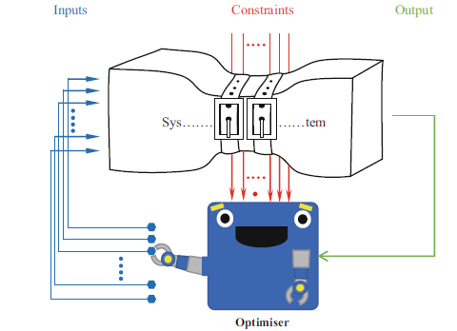
Single-Objective Optimisation
Fig. 1.2 Stochastic optimisers solve optimisation problem as a black box
Presenter: Manouchehr Abdi

Slide 7
Classification of Optimisation Algorithms
Individual-based
الگوریتم‌های مبتنی بر فرد
الگوریتم‌های مبتنی بر جمعیت
Population-based
Individual-based
الگوریتم‌های مبتنی بر فرد
با یک جواب کاندید شروع می‌کنند.
همان جواب را ارزیابی و بهبود می‌دهند تا شرط توقف برآورده شود.
مزیت: نیاز به حداقل تعداد ارزیابی تابع؛ تعداد ارزیابی تابع برابر با تعداد تکرارها است.
عیب: گرفتار شدن در بهینه‌های محلی (همگرایی زودرس).
یک جواب واحد به‌راحتی در مسائل چالش‌برانگیز واقعی در جواب‌های محلی گیر می‌افتد.
Simulated Annealing (SA)
Tabu Search (TS)
Iterated Local Search (ILS)
Hill Climbing
Presenter: Manouchehr Abdi

Slide 8
Classification of Optimisation Algorithms…
Population-based
الگوریتم‌های مبتنی بر جمعیت
از مجموعه‌ای از جواب‌های کاندید برای یافتن بهینه جهانی استفاده می‌کنند.
مزیت: کاوش بالای فضای جست‌وجو و احتمال کمتر گرفتار شدن در بهینه‌های محلی.
اگر یک جواب در بهینه محلی بیفتد، سایر جواب‌ها در تکرارهای بعدی به اجتناب از آن کمک می‌کنند.
عیب: نیاز به ارزیابی‌های تابع بیشتر و هزینه محاسباتی بالاتر.
Presenter: Manouchehr Abdi

Slide 9
Classification of Population-Based Optimisation Algorithms
Two main classes: Evolutionary and Swarm-based
Evolutionary: crossover → exploitation, mutation → exploration
Examples: GA, DE, ES, EP
Swarm-based: position vectors + movement rules
Examples: ACO, PSO
Why popular: black-box, no gradients, problem-independent, simple inspiration
Many algorithms exist: No Free Lunch (NFL) theorem — no single algorithm solves all problems
Real-world challenges: still need special considerations
Presenter: Manouchehr Abdi

Slide 10

Genetic Algorithm (GA)الگوریتم ژنتیک
Population-based evolutionary algorithm.
Chromosome = candidate solution.
Fitness = solution quality.
Operators: selection, crossover, mutation.
Loop: init → evaluate → select → crossover → mutate → replace.
Pros: derivative-free, black-box, global search.
Cons: tuning, premature convergence, no global guarantee.
Uses: optimization, scheduling, ML, robotics.
Presenter: Manouchehr Abdi

Slide 11
Evolution Strategy (ES) راهبرد تکامل
Real-valued continuous optimization.
Mutation-driven; self-adaptive step size σ.
Selection: (μ, λ) and (μ+λ).
Recombination optional.
Key variants: (1+1)-ES, CMA-ES.
Pros: derivative-free, self-adaptive, strong continuous search.
Cons: costly, tuning, local optima.
Uses: control, robotics, RL, hyperparameter tuning.
Presenter: Manouchehr Abdi

Slide 12
Evolutionary Programming (EP) برنامه‌نویسی تکاملی
Definition: Mutation-based evolutionary algorithm.
History: Introduced by Lawrence Fogel in the 1960s.
Representation: Real vectors or finite state machines.
Main Operator: Mutation only (no crossover in classic EP).
Offspring: Each parent creates one mutated child.
Selection: Probabilistic tournament between parents and offspring.
Variants: Classic EP, Fast EP, Meta-EP.
Pros: Derivative-free, continuous & combinatorial, parallelizable.
Cons: Costly, tuning, premature convergence, no global guarantee.
Applications: Optimization, control, neural nets, games, prediction, scheduling.
Presenter: Manouchehr Abdi

Slide 13
Genetic Programming (GP) برنامه‌نویسی ژنتیکی
Definition: Evolutionary algorithm that evolves computer programs.
Representation: Tree structures (functions + terminals).
Introduced by: John Koza (1990s).
Main Operators: Crossover (subtree swap), mutation (subtree/point).
Fitness: How well a program solves the task.
Selection: Fitness-based (tournament, roulette).
Variants: Tree-based GP, Linear GP, Graph GP, Grammar-based GP.
Pros: Automatic program synthesis, derivative-free, interpretable.
Cons: Bloat, costly, tuning, no global guarantee.
Applications: Symbolic regression, classification, control, robotics, feature construction.
Presenter: Manouchehr Abdi

Slide 14
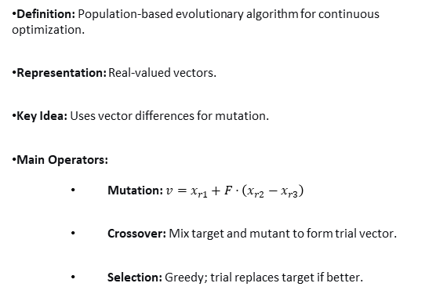
Differential Evolution (DE) تکامل تفاضلی
Definition: Population-based evolutionary algorithm for continuous optimization.
Representation: Real-valued vectors.
Key Idea: Uses vector differences for mutation.
Main Operators:
  Mutation: $v=x_{r1}+F⋅\left(x_{r2}−x_{r3}\right)$
  Crossover: Mix target and mutant to form trial vector.
  Selection: Greedy; trial replaces target if better.
Parameters: Population size (NP), mutation factor (F), crossover rate (CR).
Variants: DE/rand/1/bin, DE/best/1/bin, DE/rand/2/bin, etc.
Pros: Simple, few parameters, robust, derivative-free.
Cons: Parameter tuning, stagnation, no global guarantee.
Applications: Function optimization, engineering design, ML hyperparameter tuning, scheduling
Differential Evolution (DE) is a simple yet powerful evolutionary algorithm for continuous optimization, introduced by Storn and Price in 1995.
Presenter: Manouchehr Abdi

Slide 15
Memetic Algorithm (MA) الگوریتم میمتیک
Definition: Evolutionary algorithm combined with local search.
Also called: Hybrid evolutionary algorithm.
Key Idea: Global search (evolution) + local refinement (memes).
Representation: Problem-dependent (binary, real, permutation, tree).
Main Operators:
  Evolutionary: selection, crossover, mutation.
  Local Search: hill climbing, simulated annealing, tabu search, etc.
Local Search Frequency: every generation, every individual, or probabilistic.
Selection: Fitness-based (tournament, roulette, rank).
Variants: Lamarckian, Baldwinian, hybrid GA+local search.
Pros: Faster convergence, better exploitation, robust.
Cons: Higher computational cost, tuning, premature convergence.
Applications: TSP, scheduling, vehicle routing, engineering design, ML feature selection.
Presenter: Manouchehr Abdi

Slide 16
Coevolutionary Algorithm الگوریتم هم‌تکاملی
Definition: Multiple populations evolve simultaneously, influencing each other’s fitness.
Types: Competitive (predator-prey, host-parasite), Cooperative (problem decomposition).
Key Idea: Fitness is relative to other species, not fixed.
Representation: Problem-dependent; multiple species/populations.
Main Operators: Standard evolutionary operators within each species.
Fitness Evaluation: Based on interactions with other species.
Selection: Within each species based on interaction outcomes.
Variants: Competitive Coevolution, Cooperative Coevolution, Symbiotic.
Pros: Handles complex interactions, arms races, problem decomposition.
Cons: Complex dynamics, cycling, disengagement, tuning.
Applications: Game AI, optimization, robotics, ecosystem modeling.
Presenter: Manouchehr Abdi

Slide 17
Estimation of Distribution Algorithm (EDA) الگوریتم تخمین توزیع
Definition: Evolutionary algorithm that builds and samples a probabilistic model of promising solutions.
Also called: Probabilistic Model-Building Genetic Algorithm (PMBGA).
Key Idea: No crossover or mutation; learn the distribution of good solutions and sample new ones.
Representation: Problem-dependent (binary, real, permutation).
Main Steps: Initialize → Evaluate → Select → Estimate distribution → Sample new population → Repeat.
Definition: Evolutionary algorithm that builds and samples a probabilistic model of promising solutions.
Also called: Probabilistic Model-Building Genetic Algorithm (PMBGA).
Key Idea: No crossover or mutation; learn the distribution of good solutions and sample new ones.
Representation: Problem-dependent (binary, real, permutation).
Main Steps: Initialize → Evaluate → Select → Estimate distribution → Sample new population → Repeat.
Presenter: Manouchehr Abdi

Slide 18
Learning Classifier System (LCS) سیستم طبقه‌بند یادگیرنده
Definition: Rule-based machine learning system combining evolutionary computing and reinforcement learning.
Core Idea: Population of condition-action rules (classifiers) evolves to solve tasks.
Components: Rule (condition → action), message list, match set, action set, fitness, prediction.
Learning Mechanism: Credit assignment (e.g., Q-learning, profit sharing).
Rule Discovery: Evolutionary algorithm (typically GA) evolves rules
Main Types:
  Michigan-style: Population of rules; GA operates on individual rules.
  Pittsburgh-style: Each individual is a complete rule set; GA operates on rule sets.
  XCS: Accuracy-based fitness, prominent Michigan-style.
Selection: Fitness-based (accuracy, prediction, or both).
Pros: Interpretable, adaptive, online learning, handles sequential decision problems.
Cons: Complex, many parameters, scalability issues, no global guarantee.
Applications: Classification, data mining, robotics, control, game AI, autonomous agents.
Presenter: Manouchehr Abdi

Slide 19
Neuroevolution تکامل عصبی
Definition: Training neural networks using evolutionary algorithms instead of gradient descent.
Representation: Weights, architecture, or both.
Key Idea: Population of networks evolves; no backpropagation needed.
Main Operators: Mutation, crossover, selection.
Fitness: Task performance (accuracy, reward, error).
Variants: Fixed-topology, NEAT, HyperNEAT, CPPN, ES-based.
Pros: Derivative-free, explores architecture, parallel, handles RL.
Cons: Costly, tuning, scalability, no gradient guidance.
Applications: Reinforcement learning, games, robotics, control, simulators.
Presenter: Manouchehr Abdi

Slide 20
Multi-Objective Evolutionary Algorithm (MOEA) الگوریتم تکاملی چندهدفه
Definition: Evolutionary algorithms for problems with multiple conflicting objectives.
Goal: Find a set of trade-off solutions (Pareto front).
Key Concepts: Pareto dominance, Pareto optimality, Pareto front, non-dominated sorting, crowding distance.
Main Operators: Selection (based on dominance and diversity), crossover, mutation.
Variants: NSGA-II, SPEA2, MOEA/D, PESA-II, NSGA-III.
Pros: Finds multiple trade-offs in one run, handles conflicting objectives, no a priori weighting.
Cons: Computational cost, tuning, diversity maintenance, many-objective challenges.
Applications: Engineering design, scheduling, resource allocation, ML model selection, finance.
Presenter: Manouchehr Abdi

Slide 21
Tankyou
Presenter: Manouchehr Abdi

